Slide 1
Introduction to Probability

Slide 2

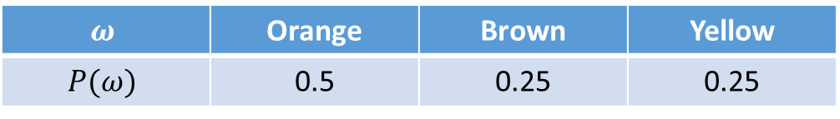
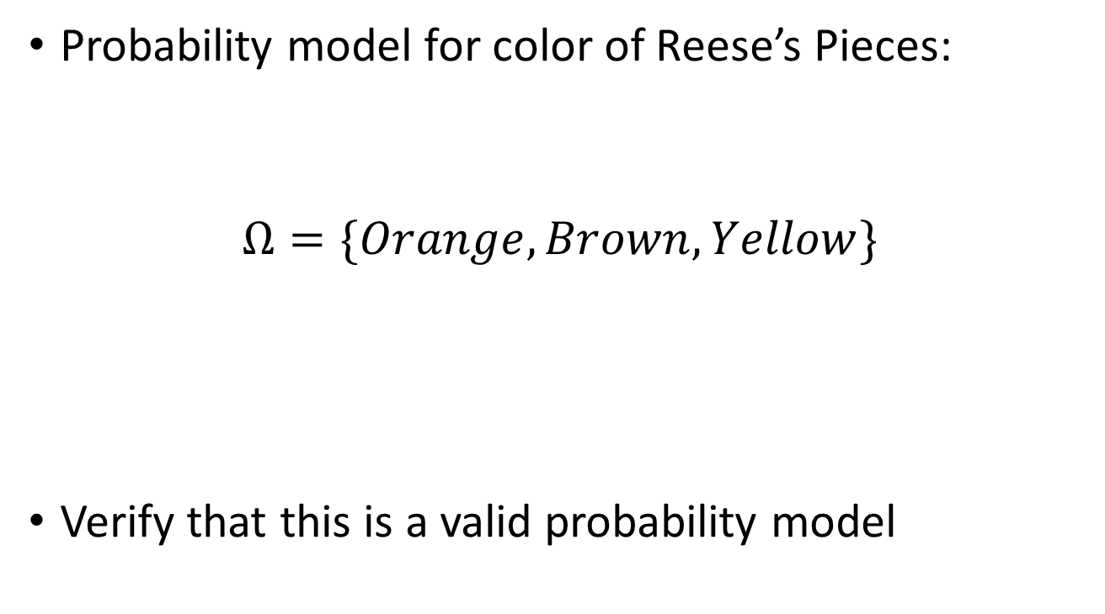
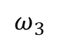
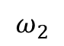
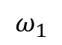
Example: Reese’s Pieces
Probability model for color of Reese’s Pieces:
$$Ω=\{Orange, Brown, Yellow\}$$
Verify that this is a valid probability model
$$ω_{1}$$
$$ω_{2}$$
$$ω_{3}$$
$$ω$$ | Orange | Brown | Yellow
$$P(ω)$$ | 0.5 | 0.25 | 0.25

Slide 3
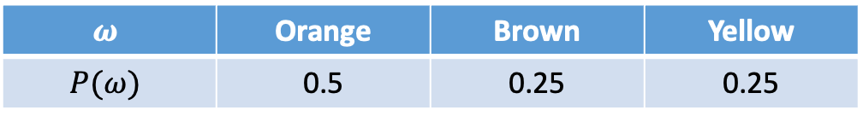
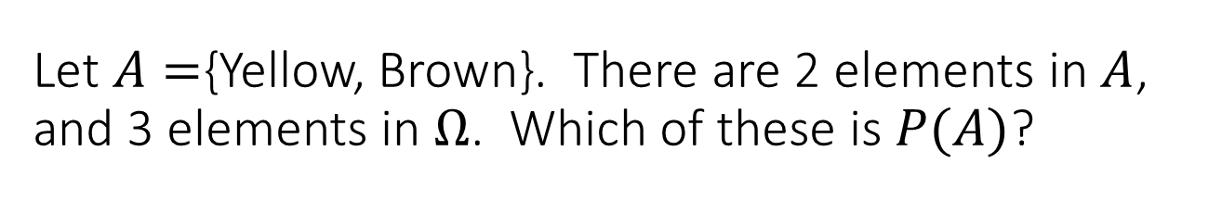
Let $A=${Yellow, Brown}. There are 2 elements in $A$, and 3 elements in $Ω$. Which of these is $P(A)$?
2/3
1/2
1/3
1
$$ω$$ | Orange | Brown | Yellow
$$P(ω)$$ | 0.5 | 0.25 | 0.25

Slide 4
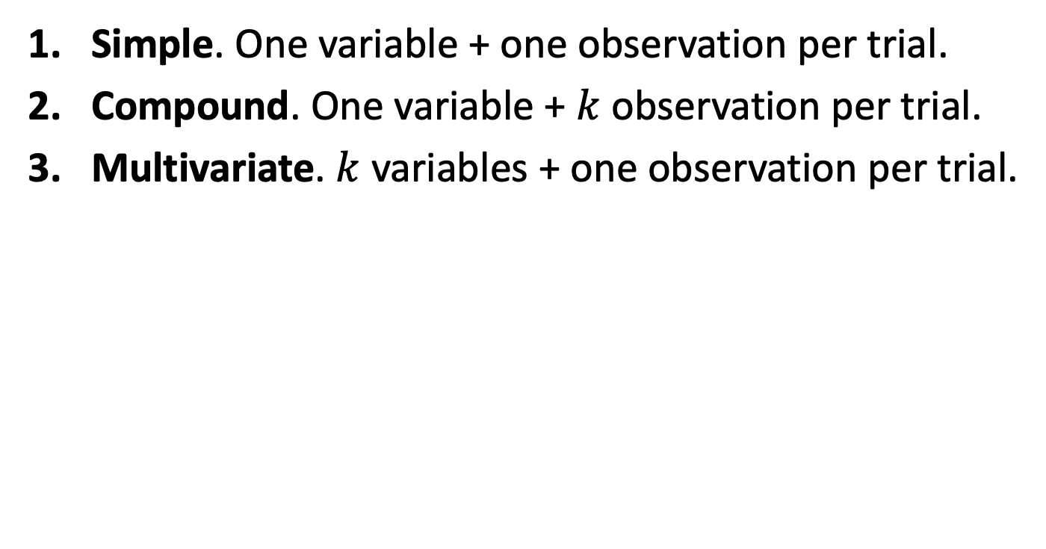
Three types of experiments
Simple. One variable + one observation per trial.
Compound. One variable + $k$ observation per trial.
Multivariate. $k$ variables + one observation per trial.

Slide 5
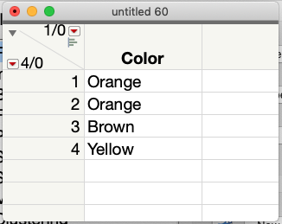
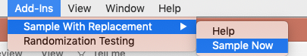
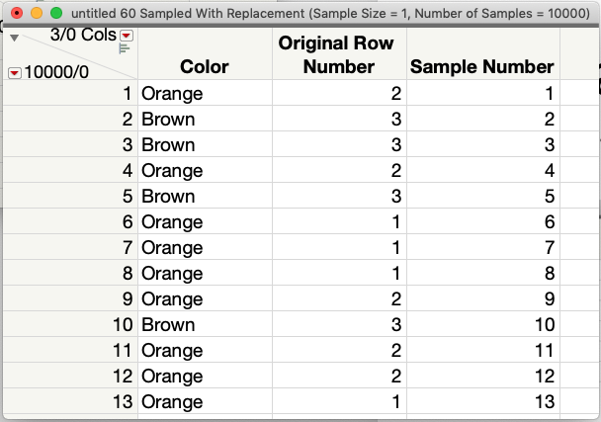
Simple Experiments in JMP
Proportional Population Table

Slide 6
Simple Experiments in R
Proportional Population Table

Slide 7
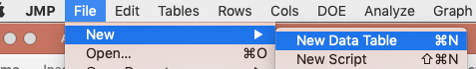
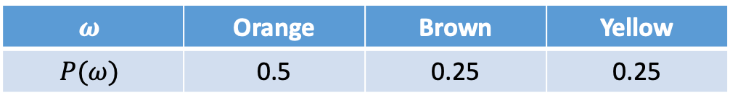
Probability Simulations in JMP Sample from a “Sample Space” Table
$$ω$$ | Orange | Brown | Yellow
$$P(ω)$$ | 0.5 | 0.25 | 0.25

Slide 8
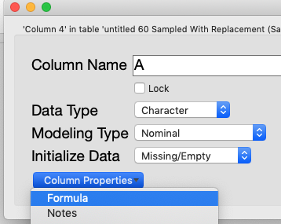
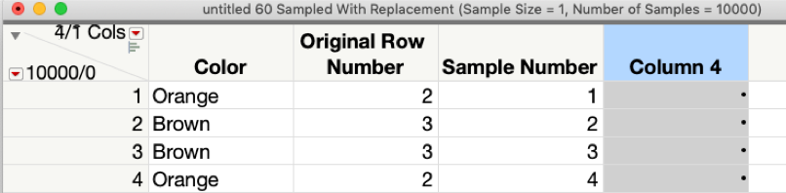
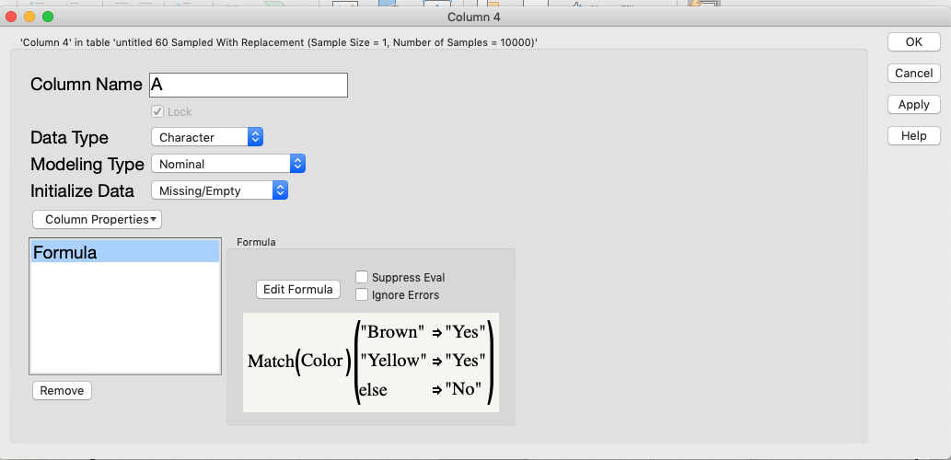
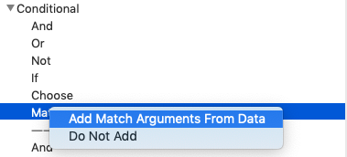
Probability Simulations in JMP Creating an event column using a formula

Slide 9
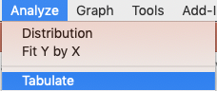
Probability Simulations in JMP Step 3 – Analyze → Validate

Slide 10
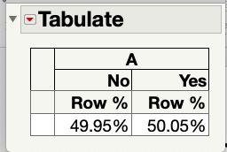
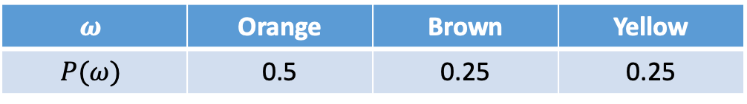
Probability Simulations in JMP Step 3 – Analyze → Validate
$$ω$$ | Orange | Brown | Yellow
$$P(ω)$$ | 0.5 | 0.25 | 0.25

Slide 11
Exercise 1.2.1
A mutual fund company offers its customers several different funds. The table to the left shows the fund type and the % of customers with shares in just one fund.
Question: For a randomly selected customer, what is the probability that they own a bond of any type?`
Tasks:
Is Tabulate to verify the proportions in the attached population table.
Approximate the answer with a JMP simulation
Answer the problem analytically (think probability == weight) and compare your answers to the simulation.
Fund Type | % Customers
Money-market | 20%
Short Bond | 15%
Intermediate Bond | 10%
Long Bond | 5%
High-risk Stock | 18%
Moderate-risk Stock | 25%
Balanced Stock | 7%

